Slide 1
Date – Event/Venue Name
Presenter Name and Title
Notes:
<Self-introduction>
It is my honor to speak to you about a topic that is of the utmost importance.
Let’s talk about life and sharing your stories.
Deep down, most of us want to know that we, in some way, made a difference in this world. That we mattered to someone. That we will be fondly remembered by those who knew and cared for us.
The foundation for meaningful memorialization are life stories.
That’s why Have the Talk of a Lifetime is so important. It’s about sitting down, sharing stories, and simply talking with your loved ones about life and the things that really matter.

Slide 2
Having the talk of a lifetime
can make the difference
of a lifetime.
Notes:
In today’s world, there is so much is going on around us. We’re busier than ever before. We’re bombarded with information from newspapers, magazine, TV, radio and the internet.
We’re sharing information with family and friends on Facebook, Twitter and by text messages.
But how often do we talk to people – I mean really talk? No cell phones ringing and dinging. No TV in the background. No distractions.
For some people, good conversation is truly a lost art.
Talking with the people in our lives who matter most – our spouses, parents, children, best friends – can have an incredibly positive impact on our relationships.
Unlike social media, talking with loved ones is unfiltered. It’s not putting your best foot forward. Talking allows us to see the real person and can help us get to know our loved ones in new and different ways.

Slide 3

Tell me about your…
Family Friends
Hopes Dreams
Accomplishments Pleasures
Talents Values
Little details Big events
Notes:
You might be thinking, “What can I talk about? My life isn’t exciting.”
Sometimes, we think we know the people we are closest to – and they think they know us. But, there’s a lot that we don’t know about them – and that they don’t know about us.
NOTE: This would be a great time in the presentation to play the 30-second video created for the 2016 campaign. Download the video from the member website at famic.org (username: famic password: campaign). Make sure to have the presentation and the video handy on your thumb drive in case there is a problem in the presentation.
Old stories about family and friends.
The things we value most in life.
Hidden talents.
What people think is your biggest accomplishment may be different than what you think is most important.
There’s actually a lot that you and a friend or loved one can talk about.

Slide 4
Tell me about…
Graduation
Getting married
Life’s big moments
A first job
Having children
Falling in love
Notes:
There is so much we experience in our lives and big moments that shape us.
But, have you talked with your spouse about your wedding day recently? Have you shared how you felt that day and let them share what they were thinking and feeling? What was their most memorable moment? What was yours?
What about your high school or college graduation day? What do you remember from that day? What do your parents remember?
What was it like when your first child was born? What was your spouse feeling that day? How did your parents feel about becoming grandparents?
These are important milestones and sources of memories. But a life story is so much more.

Slide 5
Tell me about…
The small moments that shape us
The people we meet
The places we visit
Notes:
There are also many small, quiet moments that shape us.
People we meet.
Places we visit
These may not be big things, but they play an important role in our life’s journey are a part of shaping us into who we are and what we value.
For example, have you shared with your spouse who your best friend was in high school? Are you still friends with them today? Who was your spouse’s best friend?
Have you asked your son or daughter who their favorite teacher was? Was it the teacher you thought it would be? Have you shared with your children the teacher who was most influential to you?
Although we may know about some of the big moments in the lives of our loved ones, we may not know much about other experiences and people who helped shape them.

Slide 6

Just talk…
          What was your most memorable vacation?
          What piece of advice do you cherish?
          What song reminds you of your spouse?
          What was your first job?
Notes:
Sitting down with our loved ones to talk about their lives can be rich and satisfying.
Learning about memorable events and people, places and favorite activities, values and lessons learned can help bring us closer to those we care about most.

Slide 7

Over 75% of those surveyed believe that having the
Talk of a Lifetime will be meaningful.*
*2015 Funeral and Memorial Information Council (FAMIC)
Study of American Attitudes Toward Ritualization and Memorialization
Notes:
FAMIC (The Funeral and Memorial Information Council) conducts a consumer study every 5 years. In 2015 they added questions about Have the Talk of a Lifetime. Overall those that were surveyed felt that Having the Talk and sharing stories with loved ones was meaningful.
(Survey Sample size was 1,500+. Age ranges 20 – 40+, including General Population, African American, Hispanic, and Asian populations.)

Slide 8
You can have the talk of a lifetime with anyone you hold dear.
Talk wherever you are comfortable.
The talk can take place at anytime.
Notes:
You can have the talk of a lifetime with anyone you hold dear: parents, grandparents, spouse, children, aunts and uncles.
The talk can take place at any time. Your conversation will probably be more than one conversation and it is a good idea to start the conversation now, not just toward the end of life. That way, you can share your stories and let your loved ones know what matters most, what is important.
You should talk with your loved ones wherever you are comfortable doing so: at home, a coffee shop or during a family gathering.

Slide 9
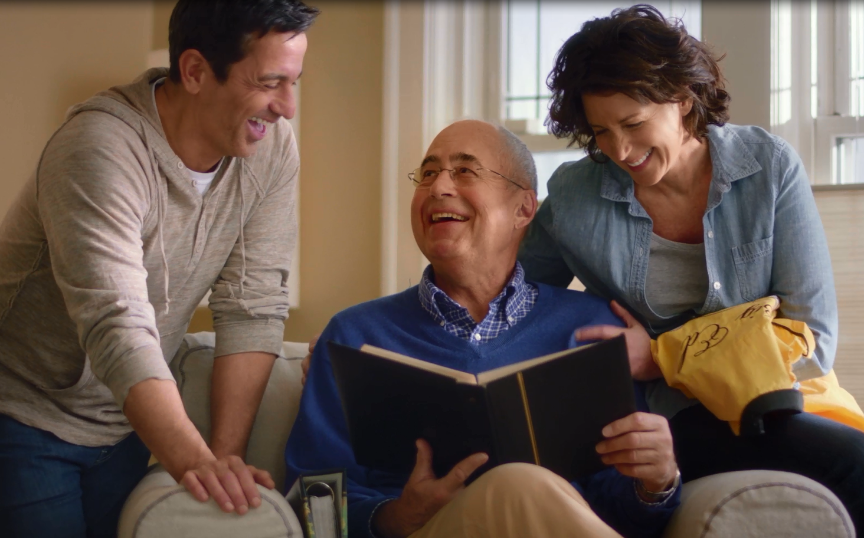
Conversations may start this way…
  “I have always liked this photo of you and uncle Tom. Tell me about where it was taken.”
  “I know you and your friends always hung out at Benny’s Diner in high school. Has it changed much?”
Notes:
There are so many ways you can get a conversation started.
Asking a loved one about a photo or place that you know was significant to their life are two examples.

Slide 10
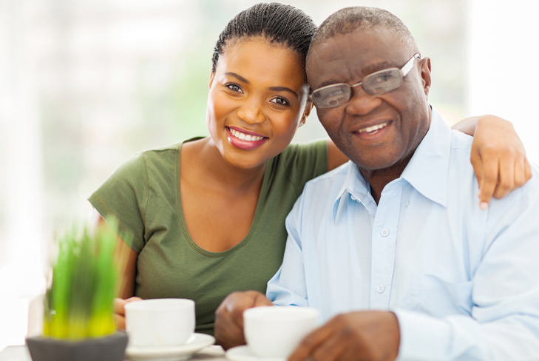
Conversations may start this way…
“What did your parents think about the music you listened to growing up?”
“Tell me about your favorite teacher.”
“What is your proudest achievement?”
Notes:
You can ask about favorite music or something about which they are proud.

Slide 11
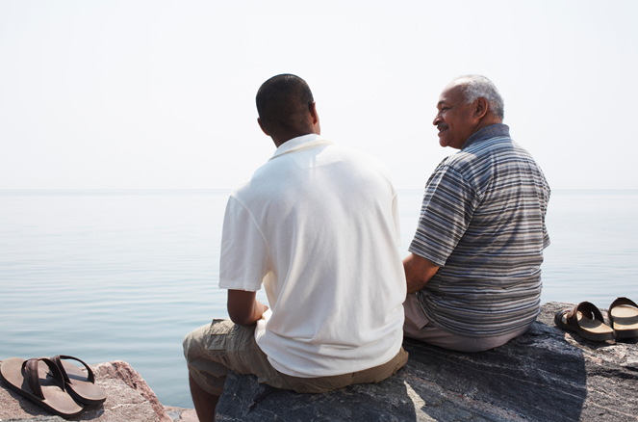
Conversations may start this way…
  “How would you like your family and friends to commemorate your life when you die?”
“Is there something special you would like us to do for you?”
Notes:
When the time is right, you should talk to your loved one about how family and friends can use their life story to remember and honor them at the end of life.

Slide 12
Listen…
…and share
Notes:
Having the talk with your loved ones is an opportunity for you to actively listen to them and learn from them.
At the same time, it’s also a chance for you to share with them how much they mean to you.
It’s somewhat like the movie “It’s a Wonderful Life.” You may recall that George Bailey thought he was a failure and that he hadn’t done anything good with his life. But the angel Clarence showed him what the world would look like without George Bailey. He saw just how much he touched his family and friends. George saw he had a wonderful life and that he mattered to a lot of people.
Like George, your loved one may not know how much they have touched your life.
Earlier I said:
“Deep down, most of us want to know that we, in some way, made a difference in this world. That we mattered to someone. That we will be fondly remembered by those who knew and cared for us.”
It is important that I to repeat it to you:
Having the talk enables you to share your own story and how it is woven together with that of your loved one. It’s your chance to let your loved one know how your life has been changed because they were a part of your story.

Slide 13
There are no rules.
The biggest challenge is getting started.
Don’t put it off…make the time.
Notes:
There are no rules for how you can have the talk. You may find that the biggest challenge is getting started, but once the conversation is going, you may find it hard to stop.
Don’t put it off. The important thing is making the time to talk!
Everyone has a story to tell and there is always something more that we can learn about the one-of-a-kind lives of our loved ones.

Slide 14
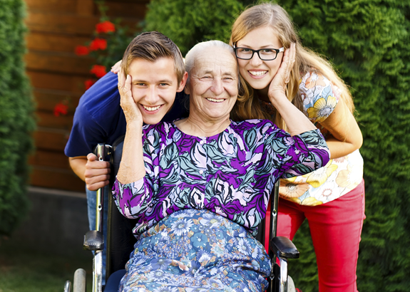
Having the talk does not have to be a one-time occurrence.
Document your memories.
  What you discuss with your loved ones may be helpful when it is time to commemorate their life.
Notes:
Talking with your loved ones shouldn’t be a one-time event. You may find yourself having regular conversations with loved ones or conversations with different groups of relatives or friends.
Some families may find it useful to document what they learn. It could be a diary. Some families make video or audio recordings – especially with older relatives – so that important family voices are permanently documented. Maybe it’s a simple document on a computer or a scrapbook.
<If you brought some of the Have the Talk of a Lifetime Workbooks printed with your logo, it would bee a good time to mention it here. You can also use the Have the Talk of a Lifetime workbook, there is a journaling section in the back of the book.>
The things you discuss may be helpful in the future when your family must make important decisions about how you wish remember them and their unique life story. Remember: the goal of any funeral, memorial service or other event is to honor your loved one in a meaningful way.
As I mentioned at the beginning, meaningful memorialization starts with life stories.

Slide 15
Memorialization has changed.
Tell the story of your loved one.
I’m here to help.
Most important: Honoring the people who matter.
Notes:
As a funeral professional, I want you to make sure that you or your loved one has your story told in a meaningful way. A way that will leave a positive impression for all who attend and participate in the service.
Funeral directors are available to support and encourage you and your family. They can provide resources to guide important conversations about all of your memorialization options.
These days, there are many options available to consumers. Funeral directors can help families understand all of their options so they can make informed decisions. Whether you desire a traditional service or something a little different, there’s always room for personalization. Creativity can make a service more meaningful and will allow family and friends to celebrate, honor and remember their loved one.
<Share more information about ways families can create personal and meaningful funerals and memorial services. Tell a story of a favorite funeral that you were a part of or attended that made a positive impression on you.
Don’t make this a sales pitch; rather, share simple ways families can personalize a funeral that are not driven by merchandise.>
What is most important is that you take time to honor and remember the people who matter.
Taking time, whether it’s a funeral, a memorial service or some other creative, out-of-the-box event, is incredibly important. It allows people who are grieving a death to begin the healing process. Funerals allow family and friends to support and comfort one another.
Getting though grief is never easy, but a meaningful funeral or memorial service can help.

Slide 16
Having the talk of a lifetime can make the difference of a lifetime.
Notes:
Today there are so many ways we can remember and honor the unique people in our lives. Memorialization should reflect your loved one’s personal values, interests and experiences and help you and others who are left behind remember what matters most.
Acknowledging the importance of loved ones in our lives is an essential step in the healing process.
Sharing your stories now and Having the Talk of a Lifetime is the first step.

Slide 17
Thank You!
www.talkofalifetime.org
Notes:
Thank you so much for being here today.
You can find more information about how to have the talk with your loved ones by visiting www.talkofalifetime.org.
I’d like to open things up for questions.
<Pause for questions. Respond as needed>
Again, thank you for being here today. I’ll stick around should any of you have any questions you’d like to discuss privately.
<Other concluding remarks>

